Slide 1
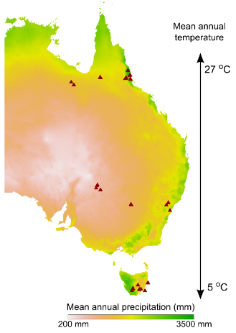
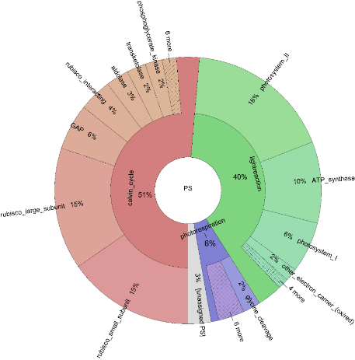
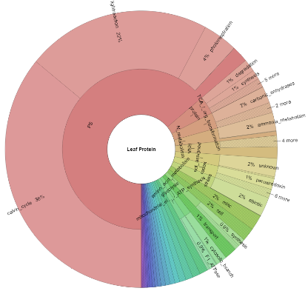
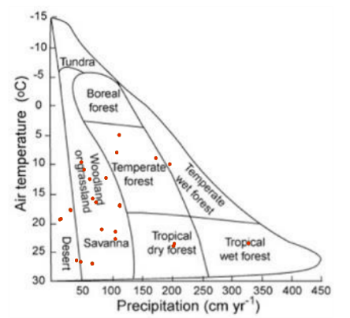
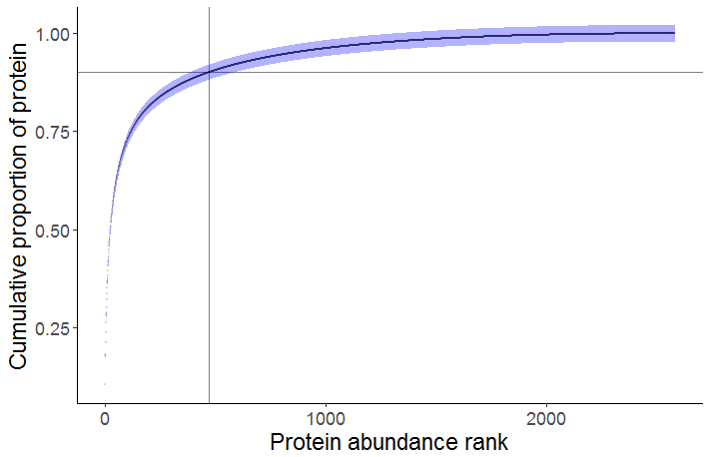
a
Photosynthesis
64%
<500 proteins account for >90% total leaf protein
Notes:
1.) Quantifying leaf proteins at the continental scale. A total of 324 photosynthetically active Eucalypt leaf samples were collected from 32 species; four species were recorded at multiple location. For each species-location combination, three canopy leaves were collected from each of three individuals to make a total of nine samples.
a.) Sampling locations (triangles) were located along three latitudinal bands, spanning broad gradients of rainfall and temperature. The resulting coverage of climate space represents of much of the vegetated area of the Australian continent;
b.) Mean annual temperature (oC) and mean annual precipitation (mm, log scaled) of sampling sites (triangles) were distributed orthogonally with respect to one another (r = );

Slide 2
a
<500 proteins account for >90% total leaf protein
Photosynthesis
64%
Notes:
1.) Quantifying leaf proteins at the continental scale. A total of 324 photosynthetically active Eucalypt leaf samples were collected from 32 species; four species were recorded at multiple location. For each species-location combination, three canopy leaves were collected from each of three individuals to make a total of nine samples.
a.) Sampling locations (triangles) were located along three latitudinal bands, spanning broad gradients of rainfall and temperature. The resulting coverage of climate space represents of much of the vegetated area of the Australian continent;
b.) Climograph of sampling sites showing biome coverage (adapted from Whittaker 1975). Mean annual temperature (oC) and mean annual precipitation (mm, log scaled) of sampling sites (triangles) were distributed orthogonally with respect to one another (r = ), and six of the nine major biome types are represented by sampling sites.
c.) Protein functional composition of the average eucalypt leaf. We used the Mercator protein functional annotation system (Lohse et al. 2013) to assign proteins to functional groupings. Here we show the average abundances of proteins associated with the major functional groupings in eucalypt leaves; angular fraction indicates the proportion of protein associated with a named functional category. The hierarchical annotation scheme is represented by the layers of the plot: the innermost layer corresponds to the broadest categories in the scheme, e.g. ‘photosynthesis’. Moving outwards, protein amounts are annotated to progressively more specific functions, e.g. ‘light harvesting complex II’. The majority of protein in leaves is associated with photosynthesis; protein synthesis, folding and degradation is the second largest top-level category. % values represent averages of leaf 324 samples across 32 eucalypt species.
d.) Abundance of photosynthesis-related proteins in the average eucalypt leaf.
Whittaker, R.H. 1975. Communities and Ecosystems. MacMillan Publishing, New York, USA.
Lohse, M., Nagel, A., Herter, T., May, P., Schroda, M., Zrenner, R., Stitt, M., & Usadel, B. (2014). Mercator: a fast and simple web server for genome scale functional annotation of plant sequence data. Plant, cell & environment, 37(5), 1250-1258.

Slide 3
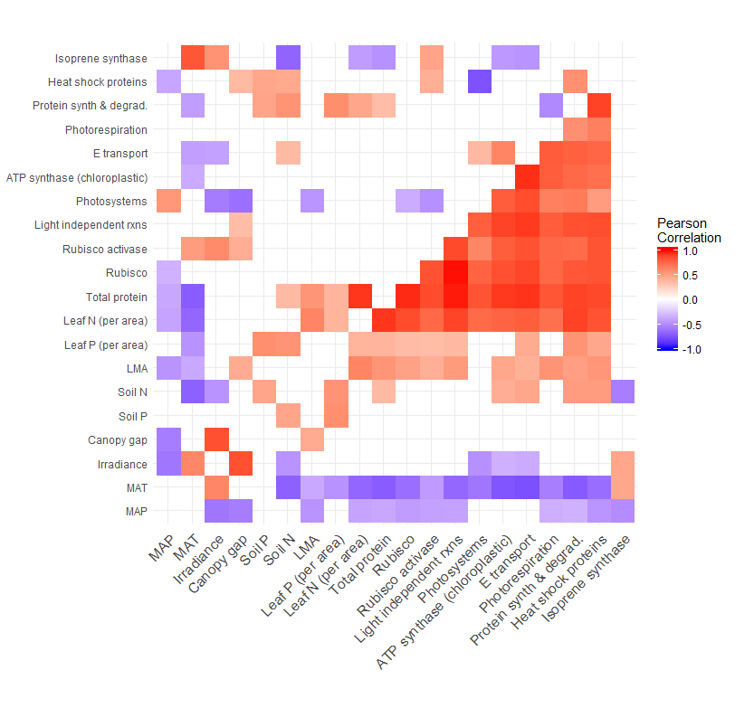
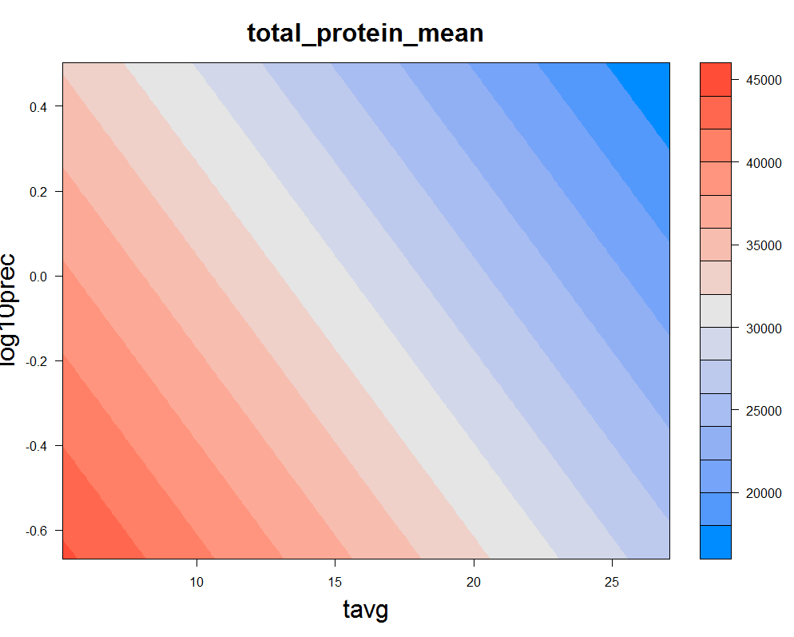
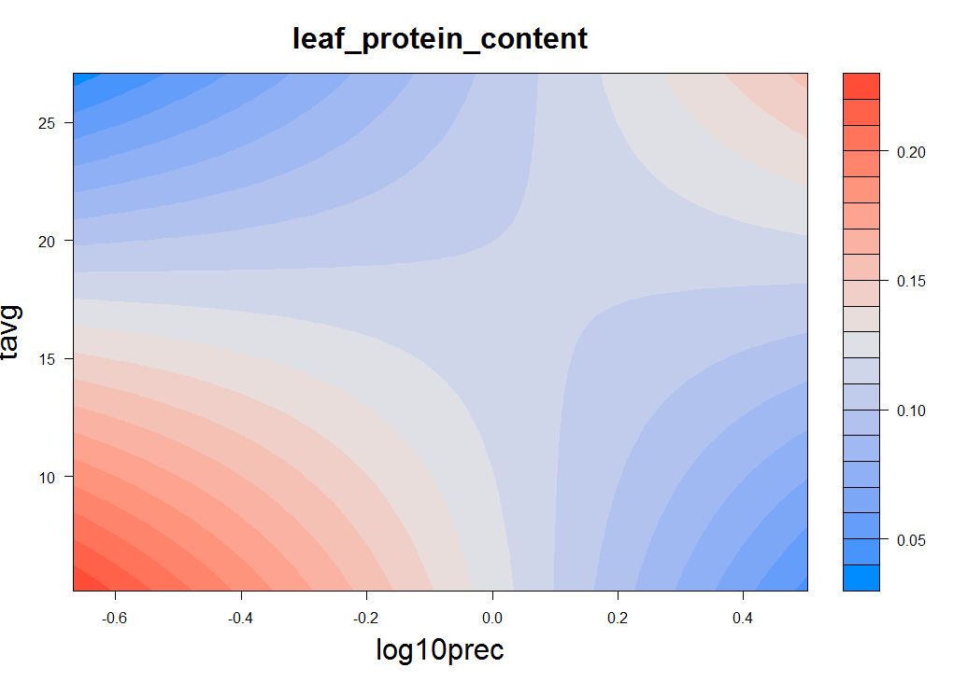
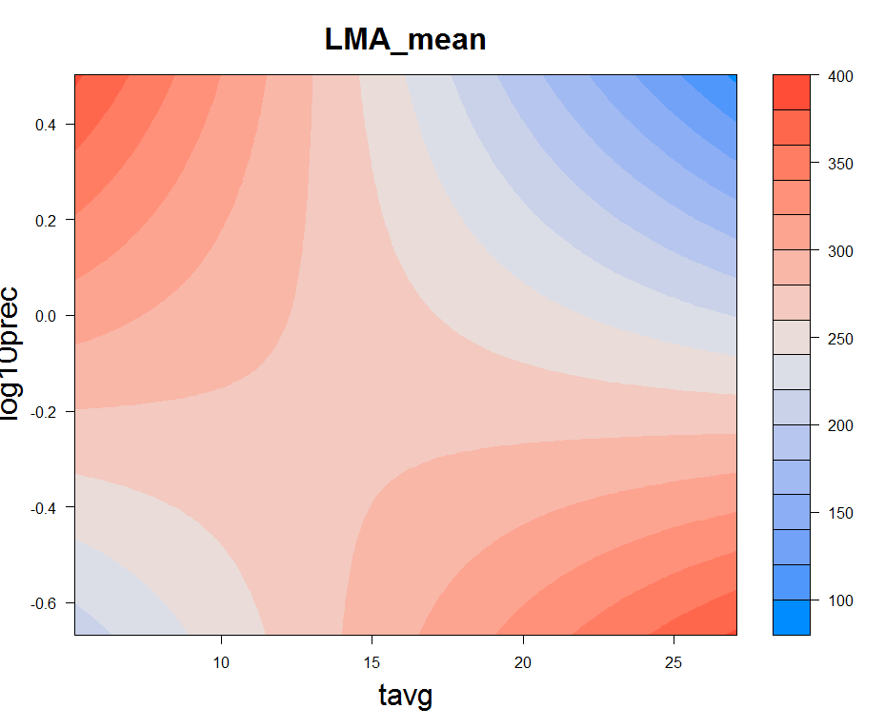
e
i
iii
v
c
i
iii
ii
iv
vi
ii
iv
Notes:
3.) Linking leaf protein abundances with environment and functional traits
a.) We are able to assess wide-area environmental patterns of leaf proteins with specific function, at any level of protein organisation. Here we show a heatmap of correlations between environmental variables, functional traits, gas exchange measurements and major protein functional categories. Pearson correlations between pairs of variables are represented by coloured tiles where p < 0.05. Protein abundances on a per leaf area basis (mg protein / m2 leaf area) are used to calculate correlations presented in the bottom/right diagonal and proportional protein abundances (i.e. fraction of total leaf protein abundance) are used to calculate correlations presented in the top/left diagonal.
b.) We selected several relationships for deeper analysis which are of current interest to the vegetation modelling community, but which to date have only been investigated via proxies. Trends in abundance of photosystem proteins [symbol, colour] and Calvin cycle enzymes [symbol, colour] are shown across gradients of: i,ii.) canopy-corrected mean annual irradiance (MJ/m2/year), R2 = , modelled change (%) = , p = ; iii,iv.) mean annual precipitation (MAP, mm/year) R2 = , modelled change (%) = , p = ; v,vi.) mean annual temperature (MAT, oC) R2 = , modelled change (%) = , p =.
Points represent the average protein abundance for individual species * site combinations (n = 9, 3 leaves from each of 3 individuals*). SEM error bars are presented for protein abundances and for canopy-corrected irradiances, since mean canopy openness values are derived from measurements of three individuals. Model fits (OLS regression) are shown where p < 0.05. A full table of univariate OLS regression statistics associated with Fig Xb and Xc is provided in the supplementary materials.
The top row of the lower panel (i, iii, v) shows models fit using protein abundances expressed on a proportional basis; the bottom row (ii, iv, vi,) shows models fit using protein abundances expressed on a per leaf area basis (mg protein / m2 leaf area).
* some species * site combinations had n < 3
c.) Influence of leaf traits on photosynthetic protein abundance. Trends in abundance of photosystem proteins [symbol, colour] and Calvin cycle enzymes [symbol, colour] are shown in relation to: i,ii.) total leaf protein per leaf area (mg/m2), R2 = , modelled change (%) = , p = ; iii,iv.) leaf mass per area (g/m2), R2 = , modelled change (%) = , p = . Plot details are as described in Fig. Xb.
d.) Multiple regression models visualised using coloration to indicate the modelled magnitude of protein abundance in two-dimensional environmental space. Curved contours indicate significant interaction effects between predictors. A full table of multiple regression statistics is presented in the supplementary materials.
i.) Proportional abundance of photosystem proteins modelled by MAT and incident irradiance (adjusted multiple R2 (adj.R2) = , p(interaction) = , etc.);
ii.) Per leaf area abundance of photosystems proteins (PS(area)) modelled by MAT and MAP (adjusted multiple R2 (adj.R2) = , p(interaction) = , etc.);
iii.) Proportional abundance of Calvin cycle proteins (Calv(prop))modelled by MAT and incident irradiance (adjusted multiple R2 (adj.R2) = , p(interaction) = , etc.);
iv.) Per leaf area abundance of Calvin cycle proteins (Calv(area)) modelled by MAT and MAP (adjusted multiple R2 (adj.R2) = , p(interaction) = , etc.).

